Slide 1
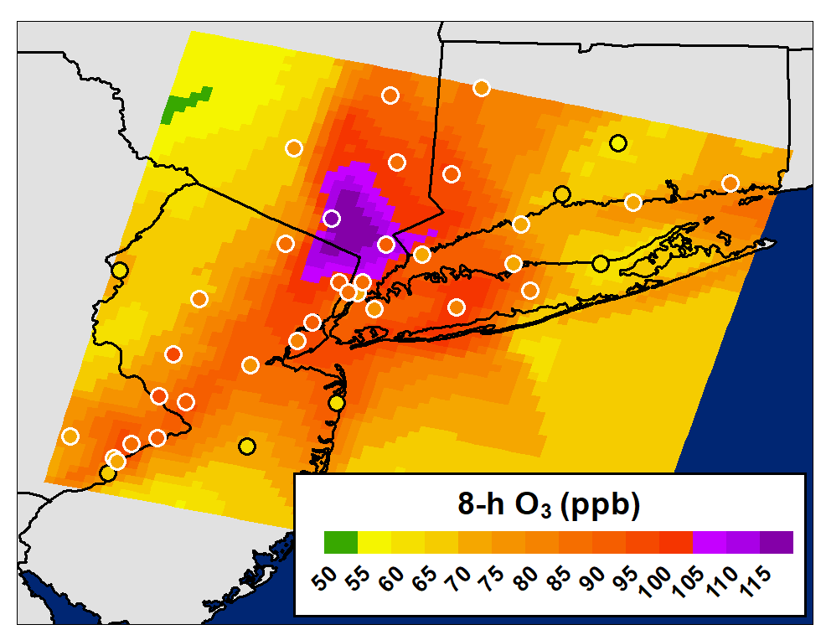
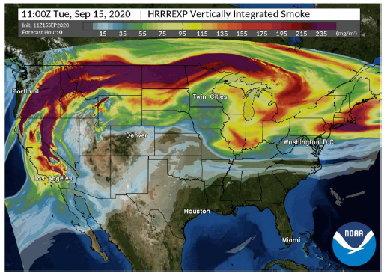
TEMPO L2 Products for AQ Forecasting
NRT Emissions for AQ Forecasting
Wildfire PM & Ozone Forecasting
NO₂, HCHO, O₃ (0-2 km)
AOD, ALH, NO₂, HCHO, glyoxal, HONO

Slide 2
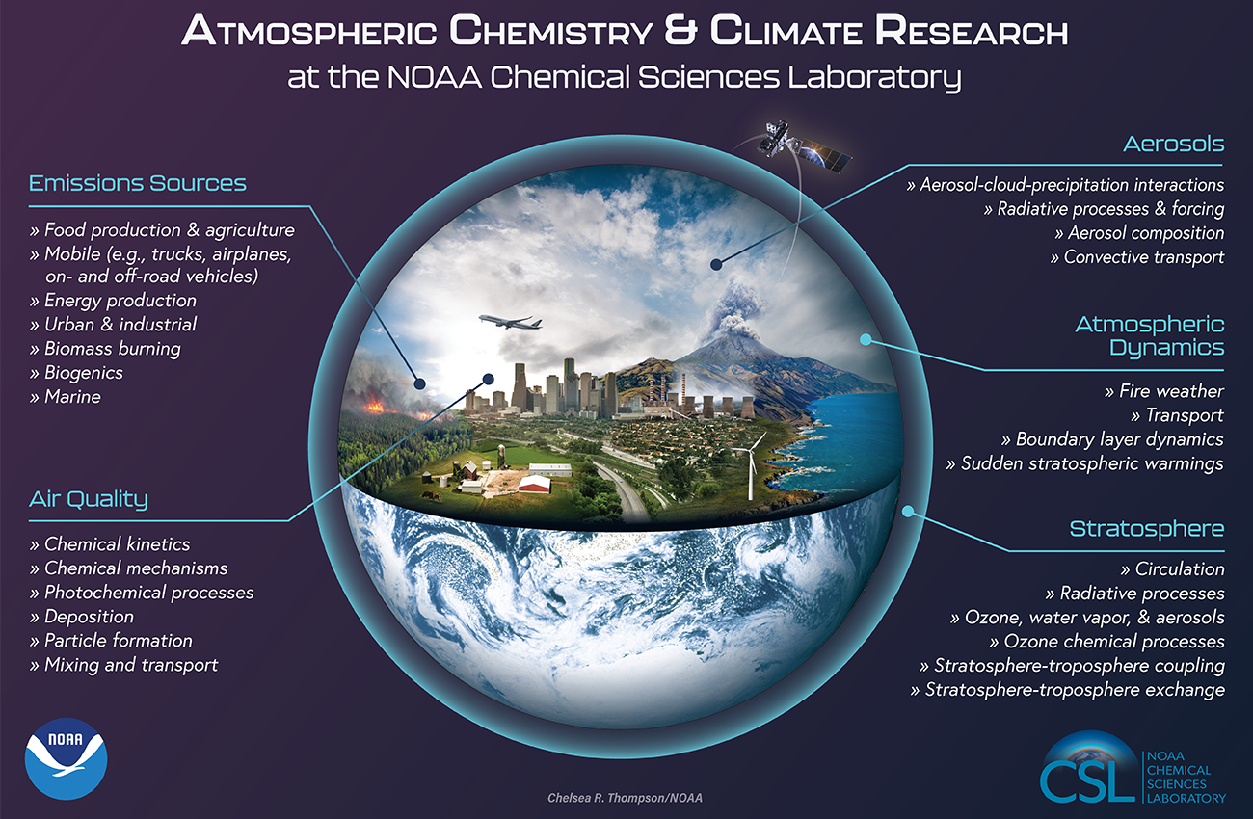
TEMPO Synergistic with NOAA CSL Research
Our Mission: To advance scientific understanding of the chemical and physical processes that affect Earth's atmospheric composition and climate.
Our Vision: A nation with the best scientific understanding and information about atmospheric chemistry and composition necessary to make optimal decisions for current and future generations.

Slide 3
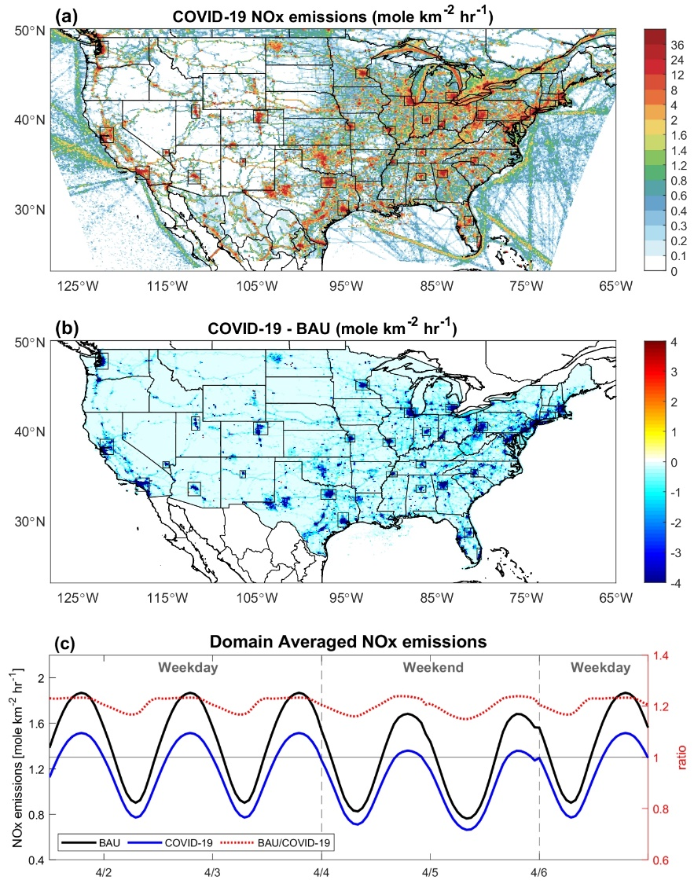
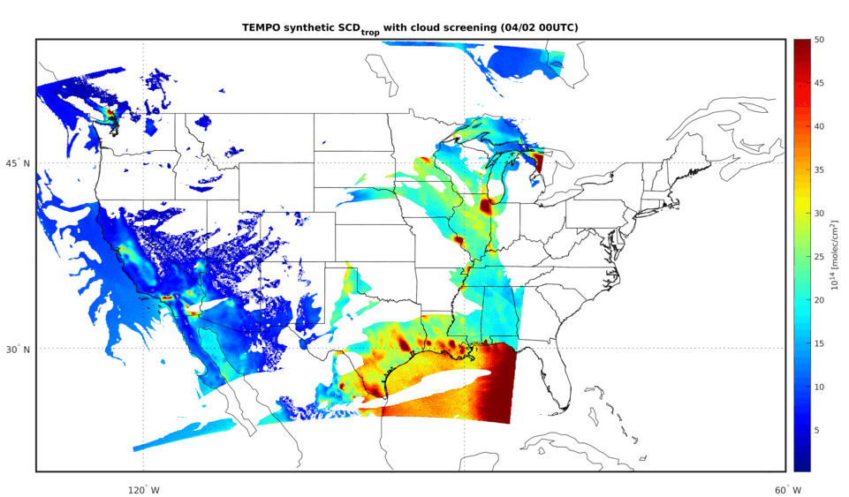

Computing Resources
Typically work with L2 Data
→ L3 Products
Modeling & Data Assimilation
Cloud-to-cloud data transfer
Cloud computing for modeling (e.g., WRF-Chem)

